Slide 1
Software Engineering

Slide 2
SOFTWARE PROJECT MANAGEMENT
Effective project management is crucial to the success of any software development project. In the past, several projects have failed not for want of competent technical professionals neither for lack of resources, but due to the use of faulty project management practices. Therefore, it is important to carefully learn the latest software project management techniques.
The main goal of software project management is to enable a group of developers to work effectively towards the successful completion of a project.

Slide 3
SOFTWARE PROJECT MANAGEMENT
Project management involves use of a set of techniques and skills to steer a project to success. A project manager is usually an experienced member of the team who essentially works as the administrative leader of the team. For small software development projects, a single member of the team assumes the responsibilities for both project management and technical management. For large projects, a different member of the team (other than the project manager) assumes the responsibility of technical leadership. The responsibilities of the technical leader includes addressing issues such as which tools and techniques to use in the project, high-level solution to the problem, specific algorithms to use, etc.

Slide 4
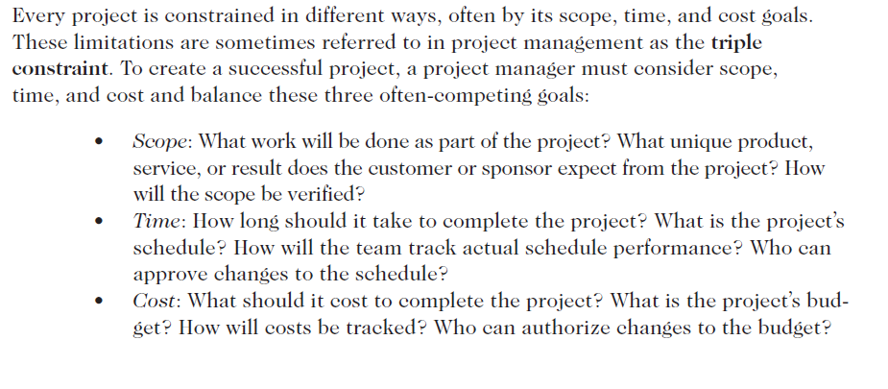
SOFTWARE PROJECT CONSTRAINT

Slide 5
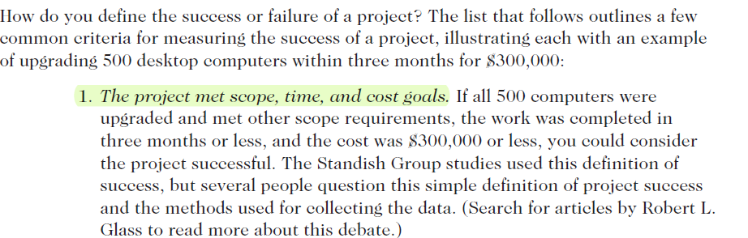
SOFTWARE PROJECT SUCCESS

Slide 6
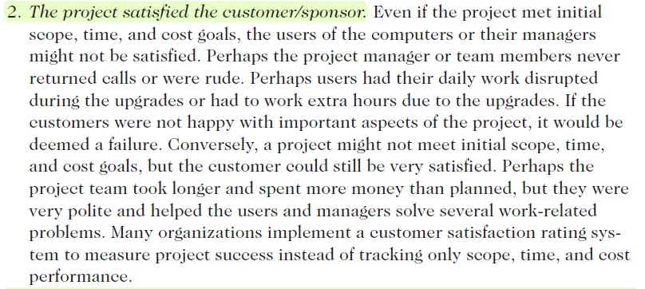
SOFTWARE PROJECT SUCCESS

Slide 7
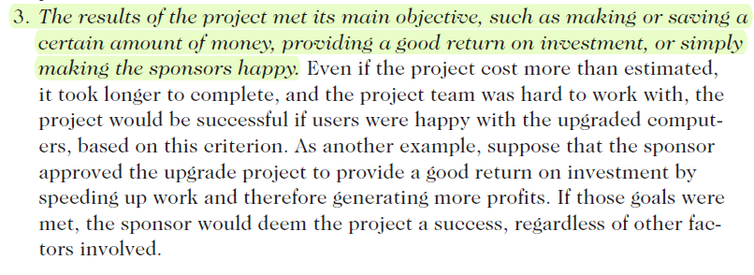
SOFTWARE PROJECT SUCCESS

Slide 8
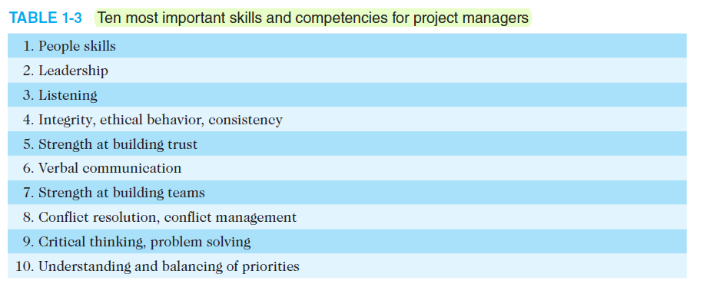

Slide 9
SOFTWARE PROJECT MANAGEMENT COMPLEXITIES
Management of software projects is much more complex than management of any other types of projects. The main factors contributing to the complexity of managing a software project are the following:
1. Invisibility: Software remains invisible, until its development is complete and it is operational. Anything that is invisible, is difficult to manage and control. Consider a house building project. For this project, the project manger can very easily assess the progress of the project through a visual examination of the building under construction. Therefore, the manager can closely monitor the progress of the project, and take remedial actions whenever he finds that the progress is not as per plan. In contrast, it becomes very difficult for the manager of a software project to assess the progress of the project due to the invisibility of software. The best that he can do perhaps is to monitor the milestones that have been completed by the development team and the documents that have been produced—which are rough indicators of the progress achieved.

Slide 10
SOFTWARE PROJECT MANAGEMENT COMPLEXITIES
2. Changeability: Because the software part of any system is easier to change as compared to the hardware part, the software part is the one that gets most frequently changed. This is especially true in the later stages of a project. As far as hardware development is concerned, any late changes to the specification of the hardware system under development usually amounts to redoing the entire project. This makes late changes to a hardware project prohibitively expensive to carry out. This possibly is a reason why requirement changes are frequent in software projects. These changes usually arise from changes to the business practices, changes to the hardware or underlying software (e.g. operating system, other applications), or just because the client changes his mind.

Slide 11
SOFTWARE PROJECT MANAGEMENT COMPLEXITIES
3. Complexity: Even a moderate sized software has millions of parts (functions) that interact with each other in many ways—data coupling, serial and concurrent runs, state transitions, control dependency, file sharing, etc. Due to the inherent complexity of the functioning of a software product in terms of the basic parts making up the software, many types of risks are associated with its development. This makes managing these projects much more difficult as compared to many other kinds of projects.

Slide 12
SOFTWARE PROJECT MANAGEMENT COMPLEXITIES
4. Uniqueness: Every software project is usually associated with many unique features or situations. This makes every project much different from the others. This is unlike projects in other domains, such as car manufacturing or steel manufacturing where the projects are more predictable. Due to the uniqueness of the software projects, a project manager in the course of a project faces many issues that are quite unlike the others he had encountered in the past. As a result, a software project manager has to confront many unanticipated issues in almost every project that he manages.

Slide 13
SOFTWARE PROJECT MANAGEMENT COMPLEXITIES
5. Team-oriented and intellect-intensive work: Software development projects are akin to research projects in the sense that they both involve team-oriented, intellect-intensive work. In contrast, projects in many domains are labor-intensive and each member works in a high degree of autonomy. Examples of such projects are planting rice, laying roads, assembly-line manufacturing, constructing a multistoried building, etc. In a software development project, the life cycle activities not only highly intellect intensive, but each member has to typically interact, review, and interface with several other members, constituting another dimension of complexity of software projects.

Slide 14
RESPONSIBILITIES OF A SOFTWARE PROJECT MANAGER
A software project manager takes the overall responsibility of steering a project to success. This surely is a very hazy job description. In fact, it is very difficult to objectively describe the precise job responsibilities of a project manager. The job responsibilities of a project manager ranges from invisible activities like building up of team morale to highly visible customer presentations. Most managers take the responsibilities for project proposal writing, project cost estimation, scheduling, project staffing, software process tailoring, project monitoring and control, software configuration management, risk management, managerial report writing and presentation, and interfacing with clients.
We can broadly classify a project manager’s varied responsibilities into the following two major categories:
• Project planning, and
• Project monitoring and control.

Slide 15
3. PROJECT PLANNING
Once a project has been found to be feasible, software project managers undertake project planning. Project planning requires utmost care and attention since commitment to unrealistic time and resource estimates result in schedule slippage. Schedule delays can cause customer dissatisfaction and adversely affect team morale. It can even cause project failure. For this reason, project planning is undertaken by the project managers with utmost care and attention. During project planning, the project manager performs the following activities;
1. Estimation: The following project attributes are estimated.
• Cost: How much is it going to cost to develop the software product?
• Duration: How long is it going to take to develop the product?
• Effort: How much effort would be necessary to develop the product?

Slide 16
3. PROJECT PLANNING
2. Scheduling: After all the necessary project parameters have been estimated, the schedules for manpower and other resources are developed.
3. Staffing: Staff organization and staffing plans are made.
4. Risk management : This includes risk identification, analysis, and abatement planning.
5. Miscellaneous plans: This includes making several other plans such as quality assurance plan, and configuration management plan, etc.
Size is the most fundamental parameter based on which all other estimations and project plans are made.

Slide 17
3.1 PROJECT SIZE ESTIMATION
Estimation of the size of software is an essential part of Software Project Management. It helps the project manager to further predict the effort and time which will be needed to build the project. The size of a project is obviously not the number of bytes that the source code occupies, neither is it the size of the executable code. The project size is a measure of the problem complexity in terms of the effort and time required to develop the product. Various measures are used in project size estimation. Some of these are:
Lines of Code
Function points
Number of entities in ER diagram
Total number of processes in detailed data flow diagram
Notes:
LOC and FP are the popular project size estimation method

Slide 18
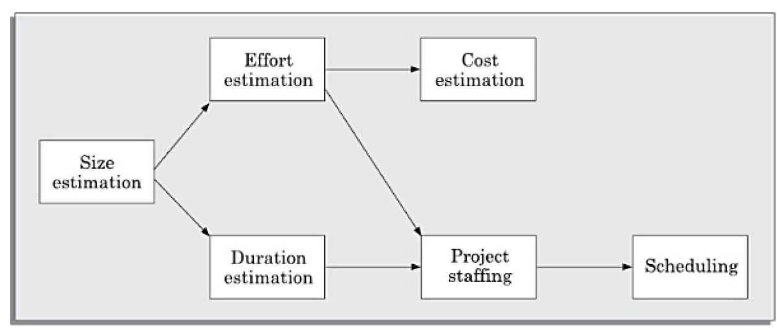
3.1 PROJECT SIZE ESTIMATION

Slide 19
3.1 PROJECT SIZE ESTIMATION
Based on the size estimation, the effort required to complete a project and the duration over which the development is to be carried out are estimated. Based on the effort estimation, the cost of the project is computed. The estimated cost forms the basis on which price negotiations with the customer is carried out. Other planning activities such as staffing, scheduling etc. are undertaken based on the effort and duration estimates made.

Slide 20
3.1.1 Lines of Code (LOC)
LOC is possibly the simplest among all metrics available to measure project size. Consequently, this metric is extremely popular. This metric measures the size of a project by counting the number of source instructions in the developed program. Obviously, while counting the number of source instructions, comment lines, and header lines are ignored. Determining the LOC count at the end of a project is very simple. However, accurate estimation of LOC count at the beginning of a project is a very difficult task. One can possibly estimate the LOC count at the starting of a project, only by using some form of systematic guess work. Systematic guessing typically involves the following. The project manager divides the problem into modules, and each module into sub-modules and so on, until the LOC of the leaf-level modules are small enough to be predicted.

Slide 21
3.1.1 Lines of Code (LOC)
To be able to predict the LOC count for the various leaf-level modules sufficiently accurately, past experience in developing similar modules is very helpful. By adding the estimates for all leaf level modules together, project managers arrive at the total size estimation. In spite of its conceptual simplicity, LOC metric has several shortcomings when used to measure problem size. Below are some limitations of LOC;
1. LOC is a measure of coding activity alone. A good problem size measure should consider the total effort needed to carry out various life cycle activities (i.e. specification, design, code, test, etc.) and not just the coding effort. LOC, however, focuses on the coding activity alone—it merely computes the number of source lines in the final program.

Slide 22
3.1.1 Lines of Code (LOC)
2. LOC count depends on the choice of specific instructions: LOC gives a numerical value of problem size that can vary widely with coding styles of individual programmers. By coding style, we mean the choice of code layout, the choice of the instructions in writing the program, and the specific algorithms used. Different programmers may lay out their code in very different ways. For example, one programmer might write several source instructions on a single line, whereas another might split a single instruction across several lines. Unless this issue is handled satisfactorily, there is a possibility of arriving at very different size measures for essentially identical programs. This problem can, to a large extent, be overcome by counting the language tokens in a program rather than the lines of code. However, a more intricate problem arises due to the specific choices of instructions made in writing the program. For example, one programmer may use a switch statement in writing a C program and another may use a sequence of if ... then ... else ... statements. Therefore, the following can easily be concluded.

Slide 23
3.1.1 Lines of Code (LOC)
3. LOC metric penalizes use of higher-level programming languages and code reuse: A paradox is that if a programmer consciously uses several library routines, then the LOC count will be lower. This would show up as smaller program size, and in turn, would indicate lower effort! Thus, if managers use the LOC count to measure the effort put in by different developers (that is, their productivity), they would be discouraging code reuse by developers. Modern programming methods such as object-oriented programming and reuse of components makes the relationships between LOC and other project attributes even less precise.

Slide 24
3.1.1 Lines of Code (LOC)
4. LOC metric measures the lexical complexity of a program and does not address the more important issues of logical and structural complexities: Between two programs with equal LOC counts, a program incorporating complex logic would require much more effort to develop than a program with very simple logic. To realize why this is so, imagine the effort that would be required to develop a program having multiple nested loops and decision constructs and compare that with another program having only sequential control flow.

Slide 25
3.1.1 Lines of Code (LOC)
5. It is very difficult to accurately estimate LOC of the final program from problem specification: At the project initiation time, it is a very difficult task to accurately estimate the number of lines of code (LOC) that the program would have after development. The LOC count can accurately be computed only after the code has fully been developed. Since project planning is carried out even before any development activity starts, the LOC metric is of little use to the project managers during project planning.

Slide 26
3.1.2 Function Point (FP) Metric
Function point metric was proposed by Albrecht in 1983. This metric overcomes many of the shortcomings of the LOC metric. Since its inception in late 1970s, function point metric has steadily gained popularity. Function point metric has several advantages over LOC metric. One of the important advantages of the function point metric over the LOC metric is that it can easily be computed from the problem specification itself. Using the LOC metric, on the other hand, the size can accurately be determined only after the product has fully been developed.
The conceptual idea behind the function point metric is the following. The size of a software product is directly dependent on the number of different high-level functions or features it supports. This assumption is reasonable, since each feature would take additional effort to implement.

Slide 27
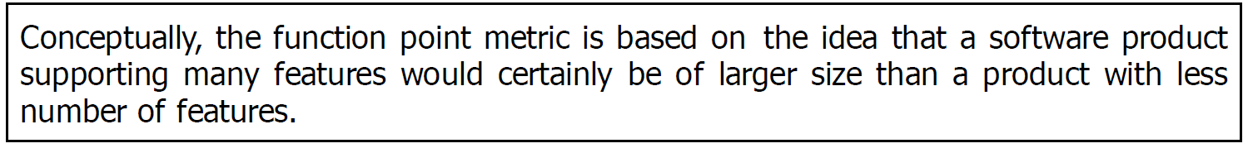
3.1.2 Function Point (FP) Metric
Though each feature takes some effort to develop, different features may take very different amounts of efforts to develop. For example, in a banking software, a function to display a help message may be much easier to develop compared to say the function that carries out the actual banking transactions. This has been considered by the function point metric by counting the number of input and output data items and the number of files accessed by the function. The implicit assumption made is that the more the number of data items that a function reads from the user and outputs and the more the number of files accessed, the higher is the complexity of the function.

Slide 28
3.1.2 Function Point (FP) Metric
Albrecht postulated that in addition to the number of basic functions that a software performs, size also depends on the number of files and the number of interfaces that are associated with the software. Here, interfaces refer to the different mechanisms for data transfer with external systems including the interfaces with the user, interfaces with external computers, etc.

Slide 29
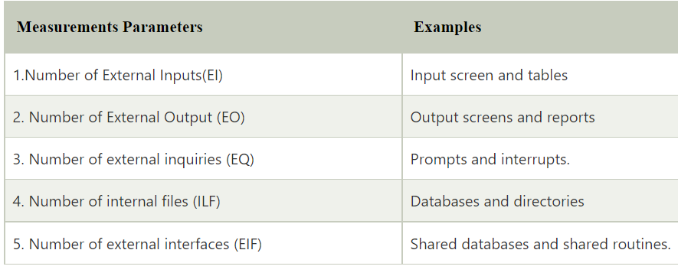
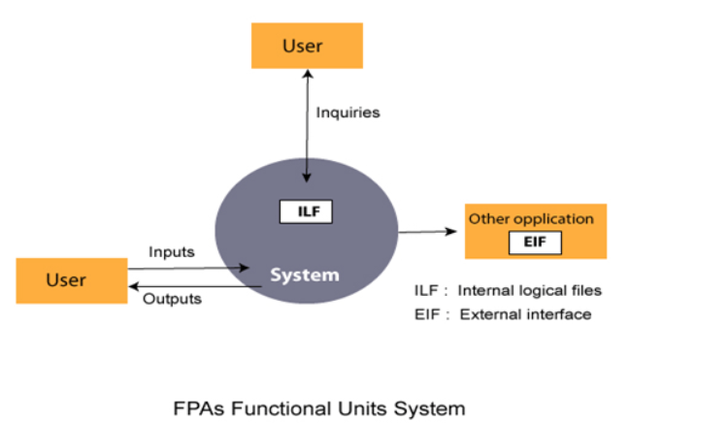
3.1.2 Function Point (FP) Metric

Slide 30
Function point (FP) metric computation
The size of a software product (in units of function points or FPs) is computed using different characteristics of the product identified in its requirements specification. It is computed using the following three steps:
Step 1: Compute the unadjusted function point (UFP) using a heuristic expression.
Step 2: Refine UFP to reflect the actual complexities of the different parameters used in UFP computation.
Step 3: Compute FP by further refining UFP to account for the specific characteristics of the project that can influence the entire development effort.

Slide 31
Function point (FP) metric computation
Step 1: UFP computation
The unadjusted function points (UFP) is computed as the weighted sum of five characteristics of a product as shown in the following expression. The weights associated with the five characteristics were determined empirically by Albrecht. However, the weights (highlighted in blue) can change depending on your discretion or the type of project you are working on.
UFP =(Number of inputs)*4 + (Number of outputs)*5 + (Number of inquiries)*4 + (Number of files)*10 + (Number of interfaces)*10

Slide 32
Function point (FP) metric computation
The meanings of the different parameters in the equation are as follows;
1. Number of inputs: Each data item input by the user is counted. However, it should be noted that data inputs are considered different from user inquiries. Inquiries are user commands such as print account-balance that require no data values to be input by the user. Inquiries are counted separately (see the third point below). It needs to be further noted that individual data items input by the user are not simply added up to compute the number of inputs, but related inputs are grouped and considered as a single input. For example, while entering the data concerning an employee to an employee pay roll software; the data items name, age, sex, address, phone number, etc. are together considered as a single input. All these data items can be considered to be related, since they describe a single employee.

Slide 33
Function point (FP) metric computation
2. Number of outputs: The outputs considered include reports printed, screen outputs, error messages produced, etc. While computing the number of outputs, the individual data items within a report are not considered; but a set of related data items is counted as just a single output.
3. Number of inquiries: An inquiry is a user command (without any data input) and only requires some actions to be performed by the system. Thus, the total number of inquiries is essentially the number of distinct interactive queries (without data input) which can be made by the users. Examples of such inquiries are print account balance, print all student grades, display rank holders’ names, etc.

Slide 34
Function point (FP) metric computation
4. Number of files: The files referred to here are logical files. A logical file represents a group of logically related data. Logical files include data structures as well as physical files.
5. Number of interfaces: Here the interfaces denote the different mechanisms that are used to exchange information with other systems. Examples of such interfaces are data files on tapes, disks, communication links with other systems, etc.

Slide 35
Function point (FP) metric computation
Step 2: Refine parameters
UFP computed at the end of step 1 is a gross indicator of the problem size. This UFP needs to be refined. This is possible, since each parameter (input, output, etc.) has been implicitly assumed to be of average complexity.
However, this is rarely true. For example, some input values may be extremely complex, some very simple, etc. In order to take this issue into account, UFP is refined by taking into account the complexities of the parameters of UFP computation. The complexity of each parameter is graded into three broad categories—simple, average, or complex. The weights for the different parameters are determined based on the numerical values shown in Table in the next slide. Based on these weights of the parameters, the parameter values in the UFP are refined. For example, rather than each input being computed as four FPs, very simple inputs are computed as three FPs and very complex inputs as six FPs.

Slide 36
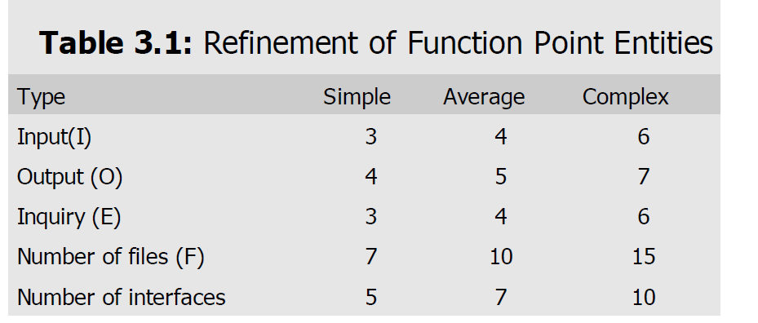
Function point (FP) metric computation

Slide 37
Function point (FP) metric computation
Step 3: Refine UFP based on complexity of the overall project
In the final step, several factors that can impact the overall project size are considered to refine the UFP computed in step 2. Examples of such project parameters that can influence the project sizes include high transaction rates, response time requirements, scope for reuse, etc. Albrecht identified 14 parameters that can influence the development effort. The list of these parameters have been shown in Table 3.2. Each of these 14 parameters is assigned a value from 0 to 5. 0=not present/no influence, 1= insignificant, 2=moderate, 3=average, 4=significant and 5=essential/ strong influence. The resulting numbers of each factor are summed, yielding the total degree of influence (DI). A complexity adjustment factor (CAF) for the project is computed and the CAF is multiplied with UFP to yield FP. The CAF expresses the overall impact of the corresponding project parameters on the development effort. CAF is computed as (0.65+0.01*DI). As DI can vary from 0 to 70, CAF can vary from 0.65 to 1.35. Finally, FP is given as the product of UFP and TCF. That is, FP=UFP*CAF

Slide 38
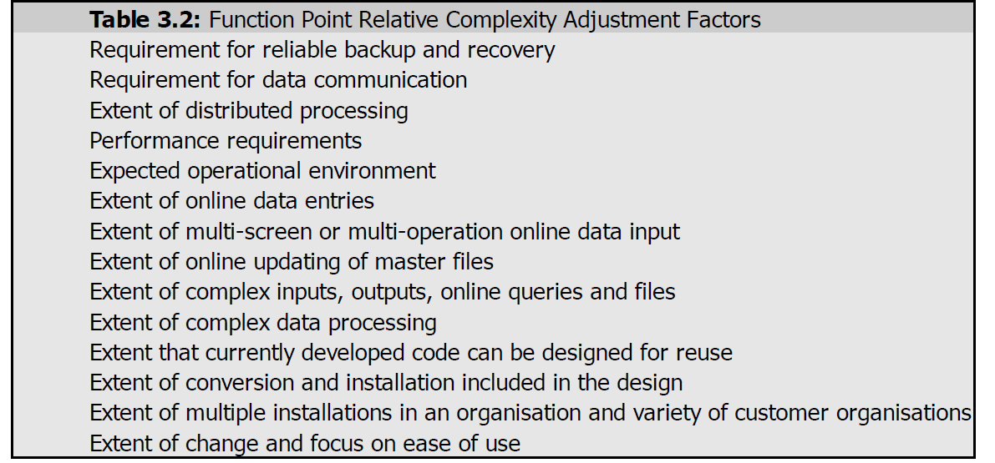
Complexity Adjustment Factors (CAF) Entities

Slide 39
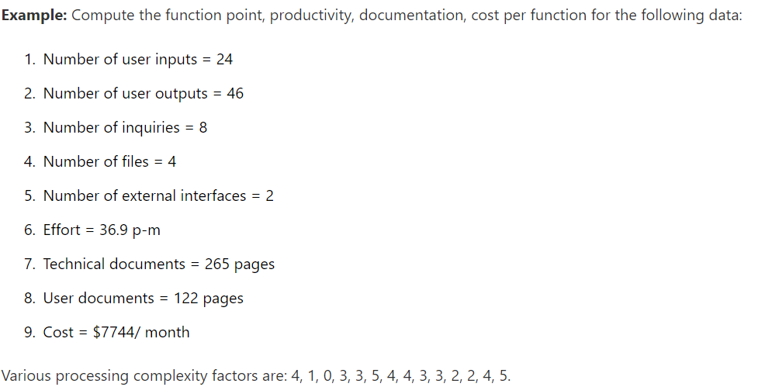
Trial 1
Calculate the UFP using Albrecht’s formula

Slide 40
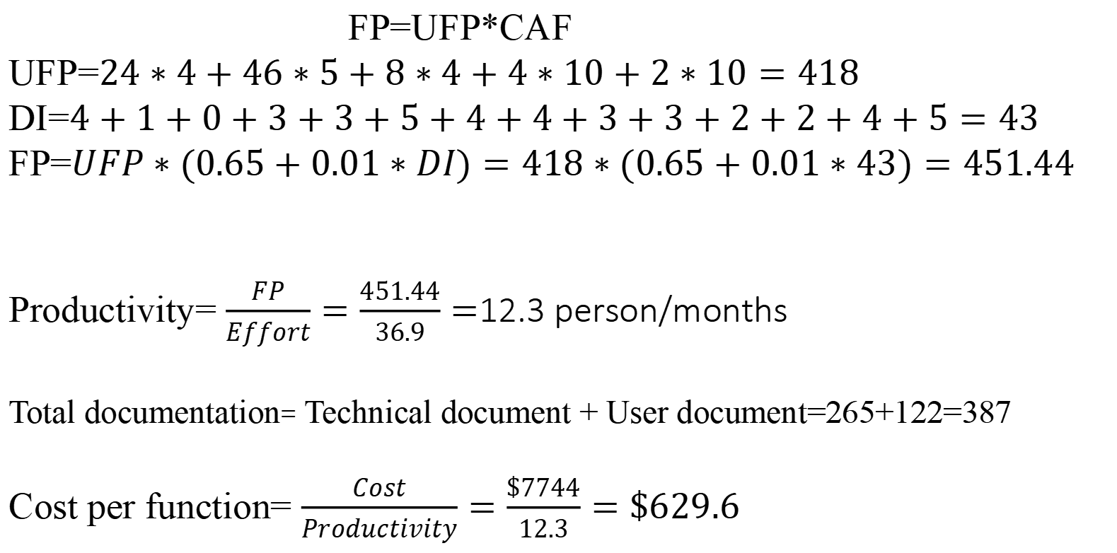
Solution
FP=UFP*CAF
UFP=$24∗4+46∗5+8∗4+4∗10+2∗10=418$
DI=$4+1+0+3+3+5+4+4+3+3+2+2+4+5=43$
FP=$UFP∗(0.65+0.01∗DI)=418∗(0.65+0.01∗43)=451.44$
Productivity= $\frac{FP}{Effort}=\frac{451.44}{36.9}=$12.3 person/months
Total documentation= Technical document + User document=265+122=387
Cost per function= $\frac{Cost}{Productivity}=\frac{\$7744}{12.3}=\$629.6$
CAF

Slide 41
Trial 2
Calculate the FPA if all complexity adjustment factors and weight adjustment factors are average for the following values for a function that handles customer registration;
Input=10, Inquiries=50, Output =30, Interface=10 and user_file=20

Slide 42
Project monitoring and control
Once a project gets underway, the project manager monitors the project continuously to ensure that it is progressing as per plan. The project manager designates certain key events such as completion of some important activity as a milestone. Once a milestone is reached, the project manager can assume that some measurable progress has been made. If any delay in reaching a milestone is predicted, then corrective actions might have to be taken.

Slide 43
Organization of the software project management plan
(SPMP) document
1. Introduction
(a) Objectives
(b) Major Functions
(c) Performance Issues
(d) Management and Technical Constraints
2. Project estimates
(a) Historical Data Used
(b) Estimation Techniques Used
(c) Effort, Resource, Cost, and Project Duration Estimates

Slide 44
Organization of the software project management plan
(SPMP) document
5. Staff organisation
(a) Team Structure
(b) Management Reporting
6. Risk management plan
(a) Risk Analysis
(b) Risk Identification
(c) Risk Estimation
(d) Risk Abatement Procedures
7. Project tracking and control plan
(a) Metrics to be tracked
(b) Tracking plan
(c) Control plan
3. Schedule
(a) Work Breakdown Structure
(b) Task Network Representation
(c) Gantt Chart Representation
(d) PERT Chart Representation
4. Project resources
(a) People
(b) Hardware and Software
(c) Special Resources

Slide 45
Organization of the software project management plan
(SPMP) document
8. Miscellaneous plans
(a) Process Tailoring
(b) Quality Assurance Plan
(c) Configuration Management Plan
(d) Validation and Verification
(e) System Testing Plan
(f ) Delivery, Installation, and Maintenance Plan

Slide 46
Skills Necessary for Managing Software Projects
Three skills that are most critical to successful project management are as follows:
• Knowledge of project management techniques.
• Decision taking capabilities.
• Previous experience in managing similar projects.

Slide 47
Organizational Structure
For every organization, there’s a need for solid structures to be put in place to aid the smooth operation and interaction between the various levels and departments. Software engineering organizations are no less different. For smooth operations and proper handling of projects, there is a need for an organizational structure.
Organization structures differ between organizations. Below are three types of organizational structure;
Functional Team or Functional Format
Matrix Team or Matrix Format
Product Team or Product Format

Slide 48
Functional Team
In this organizational structure, employees who perform the same or similar functions are put under a department. The functional teams’ system is the most widely used of the three organizational structures. It involves dividing the organization structure along functional departments like the sales department, finance department, research department, production department, etc.
Each of the departments has a head that manages every member of the team and reports to a higher authority on the organization’s leadership hierarchy. This form of organization is perfect for large firms and corporations. If your firm has a small size, it is advised to go for structures that allow for more flexibility in functions.

Slide 49
Benefits of functional teams
1. Operational Clarity: One of the significant benefits of the functional team’s organizational structure is that it allows specialists in particular fields to concentrate their effort on their areas of strength. It effectively specifies each person and department’s duties giving room for operational clarity.
2. Ease of staffing: Because this structure specifies the responsibilities of teams and departments, adding new hires into the firm becomes easier. New hires are easily onboarded into the operations of their specific departments.
3. Efficient handling of problems with human resources turnover: In an organizational structure with defined departments, issues arising from the turnover of personnel and staff are easily tackled and efficiently solved.
4. High-quality documentation practices: Due to the proper identification of teams and departments, the documentation process in firms with the functional organizational structure is always practical and top-notch.

Slide 50
Challenges of functional teams
1. Teams become siloed: Due to the separation of concerns according to departments, coworkers in this organizational structure tend to be isolated, thereby reducing the opportunities for them to meet and share perspectives.
2. Reduced flexibility to allocate resources where they are needed: Due to the levels of management within each department’s sub-units and the organization at large, it becomes a little more rigid to allocate resources as needed.

Slide 51
Product Team
Product teams are also referred to as division teams. This organizational structure for software engineering firms requires you to divide your team along product lines, geographical lines, or service lines, among others.
Each of the divisions will then have their departmental segmentation as with functional team structure. For example, you can have your firm split according to products like Mobile Application, Partner Portal, etc. etc.

Slide 52
Benefits of product teams
1. Ensures accountability: Since each of the divisions that make up a product team structure has its leadership, they operate separately from the other divisions. That makes it possible for each division to be managed effectively, making it easy for you to assess performance across divisions.
2. Fosters adaptability to market conditions: Since each division operates independently, managers can quickly adapt their division’s strategies to meet current market conditions instead of waiting for approval from higher authorities.

Slide 53
Challenges of Product teams
Cost of operation: Before adopting a product or division-based organizational structure, you must consider the cost. To setup and operate a product team’s organizational structure requires a lot of capital.
Possibilities of Inter-divisional rivalry: If the interactions between divisions are not fostered and adequately managed, it might lead to a situation where the divisions will develop unhealthy rivalry while trying to prove their superiority to other divisions within the organization.

Slide 54
Matrix Team
The matrix form of organizational structure is intended to provide the advantages of both functional and project teams. Despite being divided according to departments, matrix teams are constantly in cross-departmental cooperation. That makes it easy for them to achieve the company’s goal.
If a software engineering organization is launching a new product or starting a new marketing strategy/goal, the matrix team is always an excellent choice.

Slide 55
Benefits of matrix teams
Clearly Defined Objective: Matrix teams from inception always have a defined objective. The objective can range from the introduction of new lines of products to the creation of new strategies. Whatever the aim might be, it is always clearly defined from the beginning.
Fosters communication and cooperation among staff: If you run a matrix organizational structure for your firm, it allows your staff members to come together and jointly work to achieve a common goal.

Slide 56
Challenges of Matrix teams
The complexity of operation and authority: The primary disadvantage or challenge you might face when running a matrix team is the complexity of process and administration. Due to the multiple administration structure, matrix teams might meet conflicting directives leading to complexity in operation.
2. Requires a higher level of managerial talent: As a result of the considerable authority and complex structure of matrix teams, the managers must possess a high level of skill to deliver their job efficiently.

